Slide 1
BCSE103E- Computer Programming: JAVA
Module-6 : Java IO, Files
Dr. S.A. Amutha Jeevakumari Assistant Professor
School of Computer Science and Engineering VIT - Chennai

Slide 2

Contents
Java IO Streams
Java InputStream & Java OutputStream
Java FileInputStream & Java FileOutputStream
Java ByteArrayInputStream & Java ByteArrayOutputStream Java ObjectInputStream & Java ObjectOutputStream
Java BufferedInputStream & Java BufferedOutputStream
Java PrintStream
Java Reader & Java Writer
Java InputStreamReader & Java OutputStreamWriter Java FileReader & Java FileWriter
Java BufferedReader & Java BufferedWriter
Java StringReader & Java StringWriter Java PrintWriter
Java Files
Java Collection Frameworks
JavJava Collection Interface, Map Interface, Set Interface
Examples : Java List, ArrayList, Vector, Stack, Map, HashMap, Set, and HashSet

Slide 3
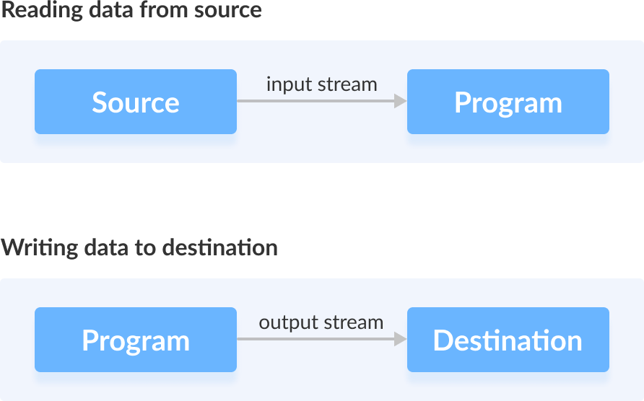
Introduction to Java IO Streams
In Java, streams are the sequence of data that are read from the source and written to the destination.
class HelloWorld {
public static void main(String[] args) { System.out.println("Hello, World!");
}
}
In the above Program, System.out is used to print a string. Here, the System.out is a type of output stream.
Similarly, there are input streams to take input.

Slide 4
What is Stream?
A stream is a sequence of data.
In Java, a stream is composed of bytes.
It’s called a stream because it is like a stream of water that continues to flow.
In Java, 3 streams are created automatically. All these streams are
attached with the console.
System.out: standard output stream System.in: standard input stream System.err: standard error stream
Example :
System.out.println("simple message"); System.err.println("error message");
Types of Streams : Byte Stream Character Stream

Slide 5
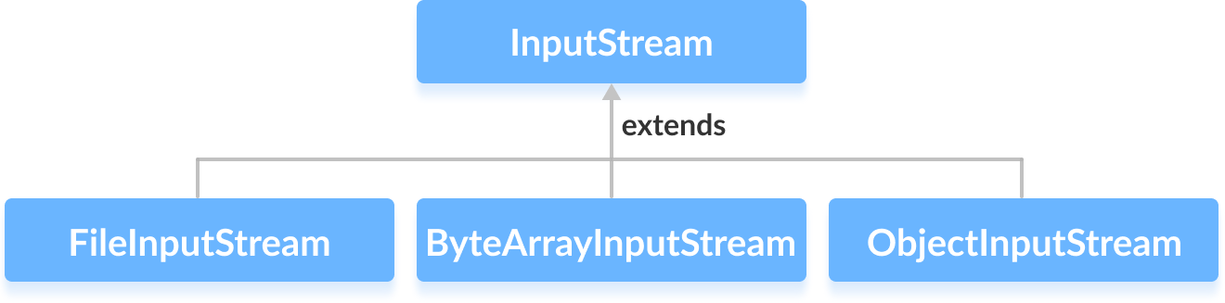
Java Byte Streams... I
Byte stream : is used to read and write a single byte (8 bits) of data.
All byte stream classes are derived from base abstract classes called
InputStream and OutputStream.
¹ Java InputStream Class: It is of the java.io package is an abstract superclass that represents an input stream of bytes.
Subclass of InputStream :
Create an InputStream :
java.io.InputStream; // Import Package First
// Creates an InputStream
InputStream object1 = new FileInputStream();
Here, we have created an input stream using FileInputStream. It is because InputStream is an abstract class.
Hence we cannot create an object of InputStream.

Slide 6
Java Byte Streams... II
Methods of InputStream : different methods that are implemented by its subclasses.
read() - reads one byte of data from the input stream
read(byte[] array) - reads bytes from the stream and
stores in the specified array
available() - returns the number of bytes available in the input stream
mark() - marks the position in the input stream up to which data has been read
reset() - returns the control to the point in
the stream where the mark was set
markSupported() - checks if the mark() and reset() method
is supported in the stream
skips() - skips and discards the specified number of bytes from the input stream
close() - closes the input stream

Slide 7
Java Byte Streams... III
import java.io.FileInputStream; import java.io.InputStream;
public class FileIOStream {
public static void main(String args[]) {
byte[] array = new byte[400]; try {
InputStream input = new FileInputStream("Input.txt");
System.out.println("Available bytes in the file: "
+ input.available());
// Read byte from the input stream
input.read(array);
System.out.println("Data read from the file: ");
// Convert byte array into string String data = new String(array); System.out.println(data);
// Close the input stream
input.close();
}
catch (Exception e) { e.getStackTrace(); }
}
}
CE1007-Java Programming

Slide 8
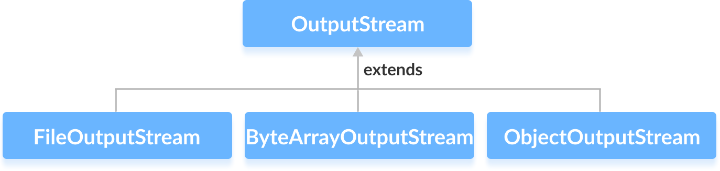
Java Byte Streams... IV
/*Available bytes in the file: 296 Data read from the file:
Java is a class-based, object-oriented programming language
that is designed to have as few implementation dependencies as possible. ...
Java applications are typically compiled to bytecode that can
run on any Java virtual machine (JVM) regardless of the underlying computer architecture.*/
² Java OutputStream Class: It is of the java.io package is an abstract
superclass that represents an output stream of bytes.
Subclasses of OutputStream
CSE1007-Java Programming

Slide 9
Java Byte Streams... V
Create an OutputStream
java.io.OutputStream // Import this Package
// Creates an OutputStream
OutputStream object = new FileOutputStream();
Methods of OutputStream : different methods that are implemented by its subclasses.
write() -
writes the specified byte to the output stream
write(byte[] array) -
writes the bytes from the specified array to the output stream
flush() - forces to write all data present in output stream to the destination
close() - closes the output stream

Slide 10
Java Byte Streams... VI
import java.io.FileOutputStream; import java.io.OutputStream;
public class FileOutStream {
public static void main(String args[]) {
String data = "Java is a class-based, OOP language \n"
+ "that is designed to have as few implementation \n"
+ "dependencies as possible. ... \n";
try {
OutputStream out = new FileOutputStream("Output.txt");
byte[] dataBytes = data.getBytes(); // Converts Str to Bytes. out.write(dataBytes); // Writes data to the output stream out.close(); // Closes the output stream
}
catch (Exception e) { e.getStackTrace(); }
}
}
/*Output.txt
Java is a class-based, object-oriented programming language that is designed to have as few implementation dependencies as possible. ... */

Slide 11
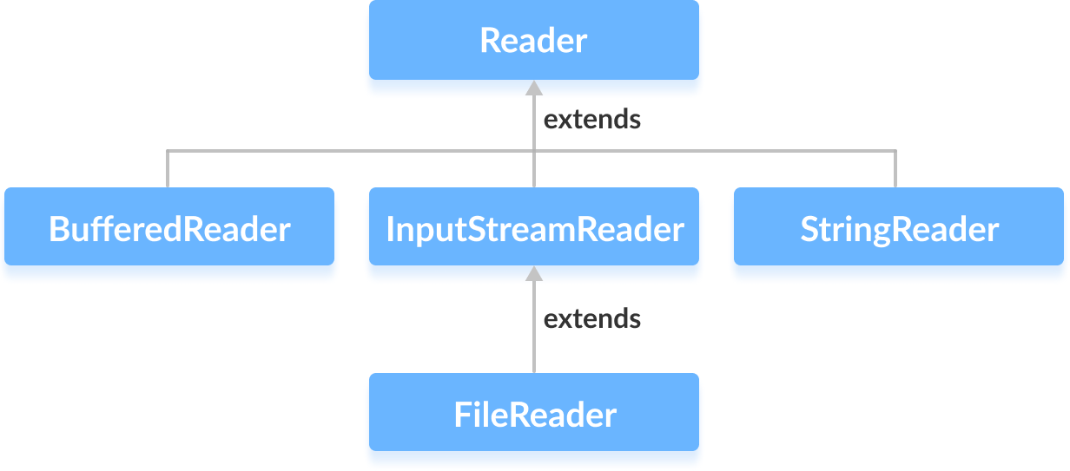
Java Character Streams... I
Character stream is used to read and write a single character of data. All the character stream classes are derived from base abstract classes
Reader and Writer.
¹ Java Reader Class : It is of the java.io package is an abstract superclass that represents a stream of characters.
Subclasses of Reader Class :
Create a Reader :
java.io.Reader // import this package
// Creates a Reader
Reader input = new FileReader();

Slide 12
Java Character Streams... II
Methods of Reader Class
ready() - checks if the reader is ready to be read
read(char[] array) - reads the characters from the stream
and stores in the specified array
read(char[] array, int start, int length) - reads the no of characters equal to length from the stream and
stores in the specified array starting from the start
mark() - marks the position in the stream up to which data has been read
reset() - returns the control to the point in the stream where the mark is set
skip() - discards the specified number of characters from the stream

Slide 13
Java Character Streams... III
import java.io.Reader; import java.io.FileReader;
class ReaderClass {
public static void main(String[] args) {
// Creates an array of character char[] array = new char[400]; try {
// Creates a reader using the FileReader
Reader input = new FileReader("Input.txt");
// Checks if reader is ready
System.out.println("Is there data in the stream? "
+ input.ready());
// Reads characters
input.read(array); System.out.println("Data in the stream:"); System.out.println(array);
// Closes the reader
input.close();
}
catch(Exception e) { e.getStackTrace(); }
}
}

Slide 14
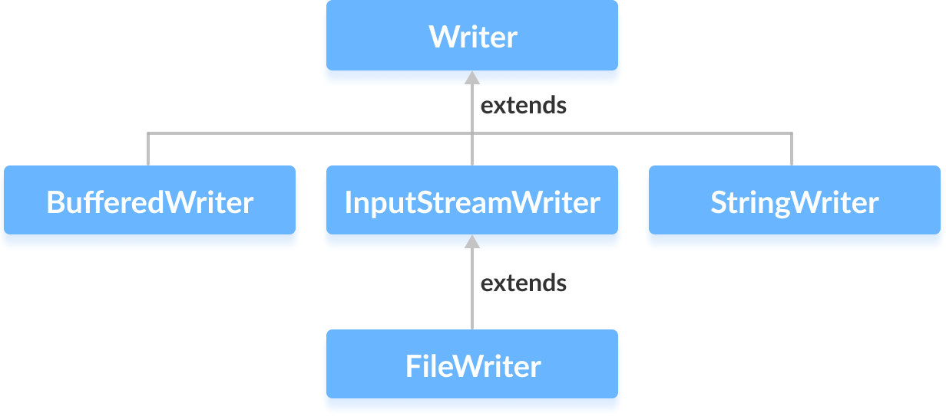
Java Character Streams... IV
² Java Writer Class : It is of the java.io package is an abstract superclass that represents a stream of characters.
Subclasses of Writer :
Create a Writer :
java.io.Writer // Import this package first;
// Creates a Writer
Writer output = new FileWriter();

Slide 15
Java Character Streams... V
Methods a Writer :
write(char[] array) - writes the characters from the specified
array to the output stream
write(String data) - writes the specified string to the writer
append(char c) - inserts the specified character to the current
writer
flush() - forces to write all the data present in the writer to the corresponding destination
close() - closes the writer
import java.io.FileWriter; import java.io.Writer;
public class WriterClass {
public static void main(String args[]) {
String data = "Java is a class-based, OOP language \n"
+ "that is designed to have as few implementation \n"
+ "dependencies as possible. ... \n";

Slide 16
Java Character Streams... VI
try {
// Creates a Writer using FileWriter
Writer output = new FileWriter("output.txt");
// Writes string to the file
output.write(data);
// Closes the writer
output.close();
}
catch (Exception e) { e.getStackTrace(); }
}
}
/*Output.txt
Java is a class-based, object-oriented programming language that is designed to have as few implementation dependencies as possible. ... */

Slide 17
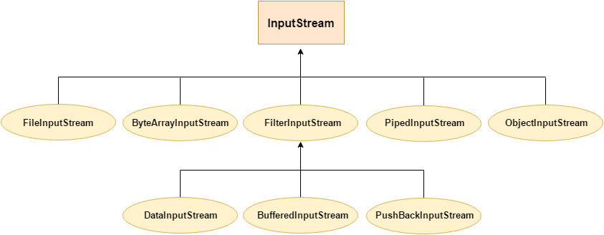
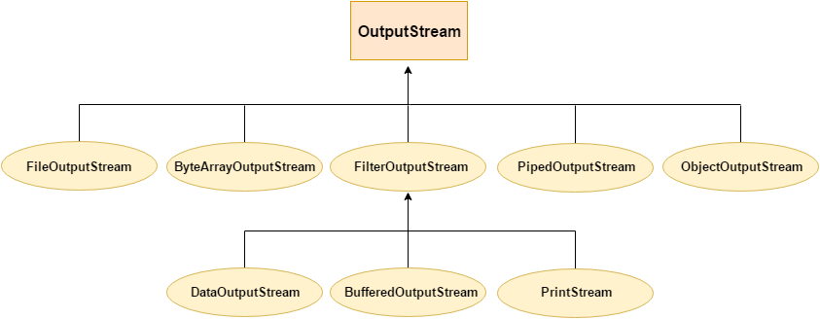
Input-Output Stream Hierarchy’s

Slide 18
Java ByteArrayInputStream Class... I
It is of the java.io package can be used to read an array of input data (in bytes). And extends the InputStream abstract class.
Create a ByteArrayInputStream :
import java.io.ByteArrayInputStream // import this package first
// Creates a ByteArrayInputStream that reads entire array
ByteArrayInputStream input = new ByteArrayInputStream(byte[] arr);
// Creates a ByteArrayInputStream that reads a portion of array
ByteArrayInputStream input = new ByteArrayInputStream(byte[] arr,
int start, int length);
Methods of ByteArrayInputStream :
read() - reads the single byte from the array present in the input stream
read(byte[] array) - reads bytes from the input stream
and stores in the specified array
read(byte[] array, int start, int length) -
reads the number of bytes equal to length from the stream and stores in the specified array starting from the position start.

Slide 19
Java ByteArrayInputStream Class... II
available() - To get the number of available bytes in the input stream.
skip() - To discard and skip the specified number of bytes
close() - To close the input stream.
finalize() - ensures that the close() method is called.
mark() - marks the position in input stream up to which data has been read.
reset() - returns the control to the point in the input stream where the mark was set.
markSupported() - checks if the input stream
supports mark() and reset()

Slide 20
Java ByteArrayInputStream Class... III
import java.io.ByteArrayInputStream;
public class ByteInputSTREAM {
public static void main(String[] args) {
byte[] array = {10, 20, 30, 40}; // Creates an Byte Array
try {
ByteArrayInputStream input = new ByteArrayInputStream(array); System.out.println("Available bytes at the beginning: "
+ input.available());
input.skip(2); // skip first 2 bytes.
System.out.print("The bytes read from the input stream: ");
for(int i= 0; i < array.length; i++) {
// Reads the bytes
int data = input.read();
if (data!=-1) System.out.print(data + ", ");
}
input.close(); // close the ByteArrayInputStream
}
catch(Exception e) { e.getStackTrace(); }
}
}
// Available bytes at the beginning: 4
// The bytes read from the input stream: 30, 40,

Slide 21
Java ByteArrayOutputStream Class... I
It is of the java.io package can be used to write an array of output data (in bytes).
Create a ByteArrayIOututStream :
import java.io.ByteArrayOutputStream
// Creates a ByteArrayOutputStream with default size
ByteArrayOutputStream out = new ByteArrayOutputStream();
// Creating a ByteArrayOutputStream with specified size
ByteArrayOutputStream out = new ByteArrayOutputStream(int size);
// Default Size = 32 Bytes;
Methods of ByteArrayOutputStream :
write(int byte) : writes the specified byte to the output stream
write(byte[] array) : writes the bytes from the specified array
to the output stream
write(byte[] arr, int start, int length) : writes the number of bytes equal to length to the output stream from an array starting from the position start
writeTo(ByteArrayOutputStream out1) : writes the entire data of the current output stream to the specified output stream

Slide 22
Java ByteArrayOutputStream Class... II
Access Data from ByteArrayOutputStream
toByteArray() : returns the array present inside the output stream
toString() : returns the entire data of the output stream in string form
Other Methods
size() : returns the size of the array in the output stream
flush() : clears the output stream
import java.io.ByteArrayOutputStream; class ByteOutputSTREAM {
public static void main(String[] args) {
String data = "At least we agree that buying a glass house" + "was a lousy idea.";
try {
// Creates an output stream
ByteArrayOutputStream out = new ByteArrayOutputStream();
byte[] array = data.getBytes(); // converts a string to Byte Array.
// Writes data to the output stream
out.write(array);
CSE1007-Java Programming

Slide 23
Java ByteArrayOutputStream Class... III
// Retrieves data from the output stream in string format String streamData = out.toString(); System.out.println("Data using toString(): " + streamData);
byte[] byteData = out.toByteArray(); System.out.print("Data using toByteArray(): "); for(int i=0; i<byteData.length; i++) {
System.out.print((char)byteData[i]);
}
out.close();
}
catch(Exception e) { e.getStackTrace(); }
}
}
// Data using toString(): At least we agree that buying a
// glass house was a lousy idea.
// Data using toByteArray(): At least we agree that buying a
// glass house was a lousy idea.
CSE1007-Java Programming

Slide 24
Java ObjectInputStream Class... I
It is of the java.io package can be used to read objects. And extends the
InputStream abstract class.
Create a ObjectInputStream :
import java.io.ObjectInputStream // import package first
// Creates a file input stream linked with the specified file
FileInputStream fileStream = new FileInputStream(String file);
// Creates an object input stream using the file input stream
ObjectInputStream objStream = new ObjectInputStream(fileStream);
Methods of ObjectInputStream :
read() : reads a byte of data from the input stream
readBoolean() : reads data in boolean form
readChar() : reads data in character form
readInt() : reads data in integer form
readObject() : reads the object from the input stream
CSE1007-Java Programming

Slide 25
Java ObjectInputStream Class... II
available() : returns the available number of bytes in the input stream
mark() : marks the position in input stream up to which data has been read
reset() : returns the control to the point in the input stream where the mark was set
skipBytes() : skips and discards the specified bytes from the input stream
close() : closes the object input stream
import java.io.FileInputStream; import java.io.FileOutputStream; import java.io.ObjectInputStream; import java.io.ObjectOutputStream; import java.io.Serializable;
class Dog implements Serializable { String name, breed;
public Dog(String N, String B) { name = N; breed = B; }
}
class ObjectInputSTREAM {
public static void main(String[] args) {
CSE1007-Java Programming

Slide 26
Java ObjectInputStream Class... III
// Creates an object of Dog class
Dog dog = new Dog("Baloo", "Australian Cattle");
try {
// Creates an ObjectInputStream, ObjectOutputStream & FileOutputStream ObjectInputStream input = new ObjectInputStream(fileStream); ObjectOutputStream output = new ObjectOutputStream(file); FileOutputStream file = new FileOutputStream("file.txt");
output.writeObject(dog); // Writes objects to output stream
FileInputStream fileStream = new FileInputStream("file.txt");
Dog newDog = (Dog) input.readObject(); // Reads the objects
System.out.println("Dog Name: " + newDog.name); System.out.println("Dog Breed: " + newDog.breed);
output.close(); input.close();
}
catch (Exception e) { e.getStackTrace(); }
}
}
// Dog Name: Baloo
// Dog Breed: Australian Cattle
CSE1007-Java Programming

Slide 27
Java ObjectOutputStream Class... I
It is of the java.io package can be used to write objects. And it extends the OutputStream abstract class.
Create a ObjectOutputStream :
import java.io.ObjectOutputStream // import package first
// Creates a FileOutputStream linked with the specified file
FileOutputStream fileStream = new FileOutputStream(String file);
// Creates the ObjectOutputStream
ObjectOutputStream objStream = new ObjectOutputStream(fileStream);
Methods of ObjectOutputStream :
write() : writes a byte of data to the output stream
writeBoolean() : writes data in boolean form
writeChar() : writes data in character form
writeInt() : writes data in integer form
writeObject() : writes object to the output stream
flush() : clears all the data from the output stream
drain() : puts all the buffered data in the output stream
close() : closes the output stream

Slide 28
Java ObjectOutputStream Class... II
import java.io.FileInputStream; import java.io.FileOutputStream; import java.io.ObjectInputStream; import java.io.ObjectOutputStream; class ObjectOutputSTREAM {
public static void main(String[] args) {
int data1 = 50;
String data2 = "This is an Example of ObjectOutputStream";
try {
FileOutputStream file = new FileOutputStream("file.txt");
// Creates an ObjectOutputStream
ObjectOutputStream output = new ObjectOutputStream(file);
// writes objects to output stream
output.writeInt(data1); output.writeObject(data2);
// Reads data using the ObjectInputStream
FileInputStream fileStream = new FileInputStream("file.txt"); ObjectInputStream objStream = new ObjectInputStream(fileStream); System.out.println("Integer data :" + objStream.readInt()); System.out.println("String data: " + objStream.readObject()); output.close(); objStream.close();
} catch (Exception e) { e.getStackTrace(); }
}
}
// Integer data :50
// String data: This is an Example of ObjectOutputStream

Slide 29
Buffered Input & Output Stream... I
Both BufferedInputStream & BufferedOutputStream class of the
java.io package is used with other input/output streams to
Create a BufferedInputStream & BufferedOutputStream :
import java.io.BufferedInputStream // import package
// Creates a FileInputStream
FileInputStream file = new FileInputStream(String path);
// Creates a BufferedInputStream
BufferedInputStream buffer = new BufferInputStream(file);
import java.io.BufferedOutputStream // import package
// Creates a FileOutputStream
FileOutputStream file = new FileOutputStream(String path);
// Creates a BufferedOutputStream
BufferedOutputStream buffer = new BufferOutputStream(file);
read/write the data (in bytes) more efficiently.

Slide 30
Buffered Input & Output Stream... II
Methods of BufferedInputStream & BufferedOutputStream :
read() : reads a single byte from the input stream
read(byte[] arr) : reads bytes from the stream and
stores in the specified array
read(byte[] arr, int start, int length) :
reads the number of bytes equal to the length from the stream & stores in the specified array starting from the position start
available() : To get the number of available bytes in the i/p stream
skip() : To discard and skip the specified number of bytes
mark() : mark the position in i/p stream up to which data has been read
reset() : returns the control to the point in the i/p stream where the mark was set
write() - writes a single byte to the internal buffer of the output stream

Slide 31
Buffered Input & Output Stream... III
write(byte[] array) - writes the bytes from the specified array
to the output stream
write(byte[] arr, int start, int length) - writes the number of bytes equal to length to the output stream from an array starting from the position start
flush() To clear the internal buffer
close() : To close the buffered input/output stream, Consider the Given Input.txt File :
/* Input.txt
Java is a class-based, object-oriented programming language that is designed to have as few implementation dependencies as possible. ...
Java applications are typically compiled to bytecode that can
run on any Java virtual machine (JVM) regardless of the underlying computer architecture.
*/

Slide 32
Buffered Input & Output Stream... IV
import java.io.FileInputStream; import java.io.BufferedInputStream; import java.io.FileOutputStream; import java.io.BufferedOutputStream;
public class BufferInputOutputStream {
public static void main(String args[]) {
try {
// Creates and Opens both Input.txt and Output.txt FileInputStream ifile = new FileInputStream("Input.txt"); FileOutputStream ofile = new FileOutputStream("output.txt");
// Creates a BufferedInputStream & BufferedOutputStream BufferedInputStream ibuffer = new BufferedInputStream(ifile); BufferedOutputStream obuffer = new BufferedOutputStream(ofile);
// Returns the available number of bytes
System.out.println("Available bytes at the beginning: "
+ ibuffer.available());
// Reads 3 bytes from the file
ibuffer.read(); ibuffer.read(); ibuffer.read();
// Returns the Remaining available number of bytes
System.out.println("Available bytes after 3 read() : "
+ ibuffer.available());

Slide 33
Buffered Input & Output Stream... V
ibuffer.skip(5); // Skip next 5 Bytes (Chars)
System.out.println("Available bytes After skip(): "
+ ibuffer.available());
// Read from File Input.txt and Write into Output.txt
int i = ibuffer.read();
while (i != -1) { obuffer.write(i);
// Reads next byte from the input stream
i = ibuffer.read();
}
//close both ibuffer and obuffer;
ibuffer.close(); obuffer.close();
}
catch (Exception e) { e.getStackTrace(); }
}
}
// Available bytes at the beginning: 296
// Available bytes at the end: 293
// Available bytes After skip(): 288

Slide 34
Buffered Input & Output Stream... VI
/* Output.txt (Generated through the program)
a class-based, object-oriented programming language
that is designed to have as few implementation dependencies as possible. ...
Java applications are typically compiled to bytecode that can
run on any Java virtual machine (JVM) regardless of the underlying computer architecture.
*/

Slide 35
Java PrintStream Class... I
It is of the java.io package can be used to write output data in commonly readable form (text) instead of bytes. And it extends the abstract class OutputStream.
It converts the primitive data (integer, character) into the text format instead of bytes. It then writes that formatted data to the output stream.
It does not throw any input/output exception and has a feature of auto flushing.
Create a BufferedInputStream
import java.io.PrintStream
Using other output streams (Option-1)
// Creates a FileOutputStream
FileOutputStream file = new FileOutputStream(String file);
// Creates a PrintStream
PrintStream output = new PrintStream(file, autoFlush); Using filename (Option-2)
// Creates a PrintStream
PrintStream output = new PrintStream(String file, boolean autoFlush);
// Creates a PrintStream using some character encoding
PrintStream output = new PrintStream(String file, boolean autoFlush,
Charset cs);

Slide 36
Java PrintStream Class... II
Methods of PrintStream
print() : prints the specified data to the output stream
println() : prints the data to the output stream along with a new line character at the end
close() : closes the print stream
checkError() : checks if there is an error in the stream
and returns a boolean result
append() : appends the specified data to the stream
import java.io.PrintStream; class PrintSTREAM {
public static void main(String[] args) {
String data = "My favorite Subject in school is nothing\n";
int age=30;
System.out.print(data); // Prints on Console
try {
PrintStream output = new PrintStream("output.txt"); output.print(data); // Write into a File output.printf("I am %d years old.", age); output.close();
}
catch(Exception e) { e.getStackTrace(); }
}
} // Analyse Program and Guess the Output ?

Slide 37
Java InputStreamReader & OutputStreamWriter... I
They are of the java.io package can be used to convert Bytes data into Character data & viceversa.
Both works with other input/output streams and are known as a bridge between byte streams and character streams.
InputStreamReader reads bytes from the input stream as characters.
OutputStreamWriter converts its characters into bytes.
Create an InputStreamReader & OutputStreamWriter
java.io.InputStreamReader;
// Creates an InputStream
FileInputStream file = new FileInputStream(String path);
// Creates an InputStreamReader or with Character encoding InputStreamReader input = new InputStreamReader(file); InputStreamReader input = new InputStreamReader(file, Charset cs);
java.io.OutputStreamWriter;
// Creates an OutputStream
FileOutputStream file = new FileOutputStream(String path);
// Creates an OutputStreamWriter or with Character encoding OutputStreamWriter output = new OutputStreamWriter(file); OutputStreamWriter output = new OutputStreamWriter(file, Charset cs);

Slide 38
Java InputStreamReader & OutputStreamWriter... II
Methods of InputStreamReader & OutputStreamWriter :
InputStreamReader Methods : -
read() : reads a single character from the reader
read(char[] array) : reads the characters from the reader
and stores in the specified array
read(char[] array, int start, int length) : reads the number of characters equal to length from the reader and stores in the specified array starting from the start
ready() : checks if the stream is ready to be read
mark() : mark the position in stream up to which data has been read
reset() : returns the control to the point in the stream where the mark was set
OutputStreamWriter Methods : -
write() : writes a single character to the writer
write(char[] array) : writes the characters from the specified
array to the writer
write(String data) : writes the specified string to the writer
flush() : forces to write all the data present in the writer to the corresponding destination
append() : inserts the specified character to the current writer

Slide 39
Java InputStreamReader & OutputStreamWriter... III
Common Methods
close() : To close the Input/Output stream
getEncoding() : used to get the type of encoding used to
store data in the input/output stream
/* Consider Input.txt
Java is a class-based, object-oriented programming language that is designed to have as few implementation dependencies as possible. ...
Java applications are typically compiled to bytecode that can
run on any Java virtual machine (JVM) regardless of the underlying computer architecture.
*/
import java.io.*;
import java.nio.charset.Charset; class InputOutputStreamReaderWriter {
public static void main(String[] args) {
char[] array = new char[500] ;

Slide 40
Java InputStreamReader & OutputStreamWriter... IV
try {
// Creates a FileInputStream
FileInputStream ifile = new FileInputStream("Input.txt"); FileOutputStream ofile = new FileOutputStream("Output.txt");
// Creates an InputStreamReader with default encoding InputStreamReader input = new InputStreamReader(ifile); InputStreamReader input2 = new InputStreamReader(ifile,
Charset.forName("UTF16"));
System.out.println("Character encoding of input: "
+ input2.getEncoding()); System.out.println("Character encoding of input: "
+ input.getEncoding());
input.read(array);
// Creates an OutputStreamWriter
OutputStreamWriter output = new OutputStreamWriter(ofile); output.write(array);
input.close();
output.close();
e.getStackTrace(); }
}
catch(Exception e) {
}
}

Slide 41
Java InputStreamReader & OutputStreamWriter... V
// Character encoding of input: UTF-16
// Character encoding of input: UTF8
/* Output.txt (File Generated)
Java is a class-based, object-oriented programming language that is designed to have as few implementation dependencies as possible. ...
Java applications are typically compiled to bytecode that can
run on any Java virtual machine (JVM) regardless of the underlying computer architecture.
*/

Slide 42
Java FileReader and FileWriter Class... I
They are of the java.io package can be used to read/write data (in characters) from files. They extends InputStreamReader and OutputStreamReader Classess respectively.
Create an FileReader & FileWriter :
import java.io.FileReader // import package first;
// Using the name of the file
FileReader input = new FileReader(String name);
FileReader input = new FileReader(String file, Charset cs);
// Using an object of the file
FileReader input = new FileReader(File fileObj);
import Java.io.FileWriter // import package first;
// Using the name of the file
FileWriter output = new FileWriter(String name);
FileWriter input = new FileWriter(String file, Charset cs);
// Using an object of the file
FileWriter input = new FileWriter(File fileObj);

Slide 43
Java FileReader and FileWriter Class... II
Methods of FileReader & FileWriter :
Methods of FileReader
read() : reads a single character from the reader
read(char[] array) : reads the characters from the reader and
stores in the specified array
read(char[] array, int start, int length) : reads the number of characters equal to length from the reader and stores in the specified array starting from the position start
ready() : checks if the file reader is ready to be read
mark() : mark the position in file reader up to which data has been read
reset() : returns the control to the point in the reader
where the mark was set
Methods of FileWriter
write() : writes a single character to the writer
write(char[] array) : writes the characters from the specified
array to the writer
write(String data) : writes the specified string to the writer
flush() : forces to write all the data present in the writer to the corresponding destination
append() : inserts the specified character to the current writer

Slide 44
Java FileReader and FileWriter Class... III
Common Methods
getEncoding() : used to get the type of encoding that is used to store/write data in the file
close() : To close the FileReader/FileWriter.
/* Consider Input.txt as below
Java is a class-based, object-oriented programming language that is designed to have as few implementation dependencies as possible. ...
*/
import java.io.*;
import java.nio.charset.Charset;
class FileReaderWriter {
public static void main(String[] args) {
char[] array = new char[500]; // Creates an array of character
try {
// Creates a reader using the FileReader FileReader input = new FileReader("Input.txt"); FileWriter output = new FileWriter("Output.txt");

Slide 45
Java FileReader and FileWriter Class... IV
input.read(array); // Reads characters from Input.txt
output.write(array); // Write Characters into Output.txt
FileReader input2 = new FileReader("Input.txt", Charset.forName("UTF1
// Returns the character encoding of the file reader System.out.println("Character encoding of input1: " + input.getEncodi System.out.println("Character encoding of input2: " + input2.getEncod
// Closes the reader and writer
input.close(); input2.close(); output.close();
}
catch(Exception e) { e.getStackTrace(); }
}
// Character encoding of input1: UTF8
// Character encoding of input2: UTF-16
}
/* Output.txt file is generated as
Java is a class-based, object-oriented programming language that is designed to have as few implementation dependencies as possible. ...
*/

Slide 46
Java BufferedReader and BufferedWriter Class... I
They are of the java.io package can be used with other readers/writers
to read/write data (in characters) more efficiently.
Create an BufferedReader & BufferedWriter :
import java.io.BuferedReader // import package first
// Creates a FileReader
FileReader file = new FileReader(String file);
// Creates a BufferedReader
BufferedReader buffer = new BufferedReader(file);
// Creates a BufferdReader with specified size internal buffer
BufferedReader buffer = new BufferedReader(file, int size);
import java.io.BufferedWriter // import pakcage first
// Creates a FileWriter
FileWriter file = new FileWriter(String name);
// Creates a BufferedWriter
BufferedWriter buffer = new BufferedWriter(file);
// Creates a BufferedWriter with specified size internal buffer
BufferedWriter buffer = new BufferedWriter(file, int size);

Slide 47
Java BufferedReader and BufferedWriter Class... II
Methods of BufferedReader & BufferedWriter :
Methods of BufferedReader
read() : reads a single character from the internal buffer of the reader
read(char[] array) : reads the characters from the reader and
stores in the specified array
read(char[] array, int start, int length) : reads the number of characters equal to length from the reader and stores in the specified array starting from the position start
skip() : To discard and skip the specified number of characters
ready() : checks if the file reader is ready to be read
mark() : mark the position in reader up to which data has been read
reset() : returns the control to the point in the reader where the mark was set
Methods of BufferedWriter
write() : writes a single character to the internal buffer of the writer
write(char[] array) : writes the characters from the specified
array to the writer
write(String data) : writes the specified string to the writer
flush() : To clear the internal buffer
newLine() : inserts a new line to the writer

Slide 48
Java BufferedReader and BufferedWriter Class... III
6. append() : inserts the specified character to the current write
Common Methods :
1. close() Method : To close the buffered reader/buffered writer
/* Consdier Input.txt
Java is a class-based, object-oriented programming language that is designed to have as few implementation dependencies as possible. ...
*/
import java.io.*;
public class BufferedReaderWriter {
public static void main(String args[]) {
char[] array = new char[500]; // Creates an character array
try {
FileReader ifile = new FileReader("Input.txt"); FileWriter ofile = new FileWriter("Output.txt");
// Creates a BufferedReader
BufferedReader input = new BufferedReader(ifile);

Slide 49
Java BufferedReader and BufferedWriter Class... IV
BufferedWriter output = new BufferedWriter(ofile);
// Skips the 10 characters
input.skip(10); input.read(array);
// Reads the characters
output.write(array);
// closes the reader and writer
input.close(); output.close();
}
catch (Exception e) { e.getStackTrace(); }
}
}
/* Output.txt file is generated.
class-based, object-oriented programming language
that is designed to have as few implementation dependencies as possible. ...
*/

Slide 50
_{Java Stri}T_{n}h_{g}e_{R}y _{e}a_{a}re_{de}o_{r}f t&he_{S}ja_{t}v_{ri}a_{n}.i_{g}o_{W}pa_{ri}c_{t}k_{e}a_{r}ge_{I} can be used to read/write data (in
characters) from strings. And extends the abstract class Reader.
Create an StringReader & StringWriter :
import java.io.StringReader // import package first
// Creates a StringReader
StringReader input = new StringReader(String data);
import java.io.StringWriter // import package first
// Creates a StringWriter
StringWriter output = new StringWriter();
// Creates a StringWriter with specified string buffer capacity
StringWriter output = new StringWriter(int size);
Methods of StringReader & StringWriter :
// Methods of StringReader :
read() : reads a single character from the string reader
read(char[] array) : reads the characters from the reader
and stores in the specified array
read(char[] array, int start, int length) : reads the number
of characters equal to length from the reader and stores in the specified array starting from the position start
skip() : To discard and skip the specified number of characters
ready() : checks if the string reader is ready to be read
6. mark() : marks the position in reader up to which data has been read

Slide 51
Java StringReader & StringWriter II
7. reset() : returns the control to the point in the reader where the mark was set
//Methods of StringWriter :
write() : writes a single character to the string writer
write(char[] array) : writes the characters from the
specified array to the writer
write(String data) : writes the specified string to the writer
getBuffer() : returns the data present in the string buffer
toString() : returns the data present in the string buffer as a string
flush() : forces to write all the data present in the writer
to the string buffer
append() : inserts the specified character to the current writer
import java.io.*;
public class StringReaderWriter {
public static void main(String[] args) {
String data = "Java is a class-based, object-oriented programming \n"
+ "language that is designed to have as few implementation \n"
+ "dependencies as possible. ... ";
// Create a character array
char[] array = new char[500];
51/ 95

Slide 52
Java StringReader & StringWriter III
try {
// Create a StringReader
StringReader input = new StringReader(data); StringWriter output = new StringWriter();
input.skip(5); // Use the skip() method input.read(array); //Use the read method System.out.println("Data after skipping 5 characters:"); System.out.println(array);
output.write(data);
// Returns the string buffer
StringBuffer stringBuffer = output.getBuffer(); System.out.println("StringBuffer: " + stringBuffer);
// Returns the string buffer in string form String string = output.toString(); System.out.println("String: " + string);
input.close(); output.close(); // Close both Reader/Writer
}
catch(Exception e) { e.getStackTrace(); }
}
}

Slide 53
Java StringReader & StringWriter IV
/*
Data after skipping 5 characters:
is a class-based, object-oriented programming
language that is designed to have as few implementation dependencies as possible. ...
StringBuffer: Java is a class-based, object-oriented programming
language that is designed to have as few implementation dependencies as possible. ...
String: Java is a class-based, object-oriented programming
language that is designed to have as few implementation dependencies as possible. ...
*/

Slide 54
Java PrintWriter I
It is of the java.io package can be used to write output data in a commonly readable form (text). And extends the abstract class Writer.
It converts the primitive data (int, float, char, etc.) into the text format. It then writes that formatted data to the writer.
Create an PrintWriter :
java.io.PrintWriter // import package first;
// Using other writers
// Creates a FileWriter
FileWriter file = new FileWriter("output.txt");
// Creates a PrintWriter
PrintWriter output = new PrintWriter(file, autoFlush);
// Using other output streams
// Creates a FileOutputStream
FileOutputStream file = new FileOutputStream("output.txt");
// Creates a PrintWriter
PrintWriter output = new PrintWriter(file, autoFlush);
// Using Filename
// Creates a PrintWriter
PrintWriter output = new PrintWriter(String file, boolean autoFlush);
// Creates a PrintWriter using some character encoding
PrintWriter output = new PrintWriter(String file,
boolean autoFlush, Charset cs);

Slide 55
Java PrintWriter II
Methods of PrintWriter :
print() : prints the specified data to the writer
println() : prints the data to the writer along with a new line character at the end
printf() : used to print the formatted string.
close() : closes the print writer
checkError() : checks if there is an error in the writer
and returns a boolean result
append() : appends the specified data to the writer
import java.io.PrintWriter; class PRINTWRITER {
public static void main(String[] args) {
int age = 50;
String data = "Java is a class-based, OOP Language \n"
+ "that is designed to have as few implementation dependencies \n"
+ "as possible.... ";

Slide 56
Java PrintWriter III
try {
PrintWriter output = new PrintWriter("Output.txt");
output.print(data);
output.printf("\nI am %d years old.", age); output.close();
}
catch(Exception e) { e.getStackTrace(); }
}
}
/* Output.txt is Generated
Java is a class-based, OOP Language
that is designed to have as few implementation dependencies as possible....
I am 50 years old.
*/

Slide 57

Thanks

